Slide 1

The New-art of attending students (N.A.A.S)
- The Outliers

Slide 2

G0al
We seek to provide a valuable attendance service for both teachers and students. Reduce manual process errors by providing automated and a reliable attendance system that uses face recognition technology.

Slide 3
objective
The main intention of this project is to disseminate the information in an environment that encourages accountability, relevance and retention of the information gathered through facial recognition of the students. We’ve inundated with data of all kinds, but the plethora of photo and video data available provides the dataset required to make facial recognition technology work. Machine learning and artificial intelligence capabilities in the software map distinguishable facial features mathematically, look for patterns in the visual data, and compare new images and videos to other data stored in facial recognition databases to determine identity, security and protection.

Slide 4

Team members
Firdavs
Mushtariy
Sourav

Slide 5
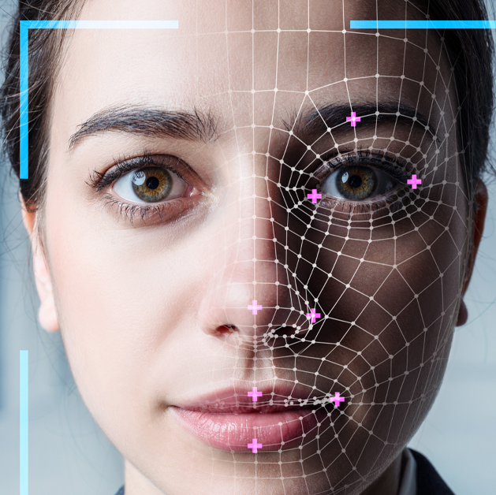
Algorithms Used:
Haar Cascade
OpenCv

Slide 6
Main Modules used (python)
OPENCV– Used for image and video analysis
PILLOW- Adds support for opening, manipulating, and saving images
NUMPY- Working with arrays
PANDAS- Data science/data analysis and machine learning tasks
SMTPLIB - Client session object, to send mail to any internet machine
CSV - Common import and export format for spreadsheets
TKINTER - Build-in GUI toolkit

Slide 7

Role 1 (Firdavs) : Email client configuration.
Smtplib is used in order to send email to all the succesful present students.
First initialize connection to email server.
Login with youremail and password.
Call the message function and make a list of emails you wanna send mail to.
Finally, Close the connection.

Slide 8
Role 2 (Mushtariy) : Face Recognition , detection and Excel sheet configuration.
Registering images (Save id , capture faces, train)
Load Cascade
Detect face
Mark attendance in CSV file.

Slide 9


Role 3 (Sourav) :
GUI, Documentation.
Users interact with information by manipulating visual widgets, which are designed to respond in accordance with the type of data they hold and support the actions necessary to complete the user’s task.
GUI frontend
MenuBar
TreeView Attendance Table
ScrollBar
Buttons

Slide 10
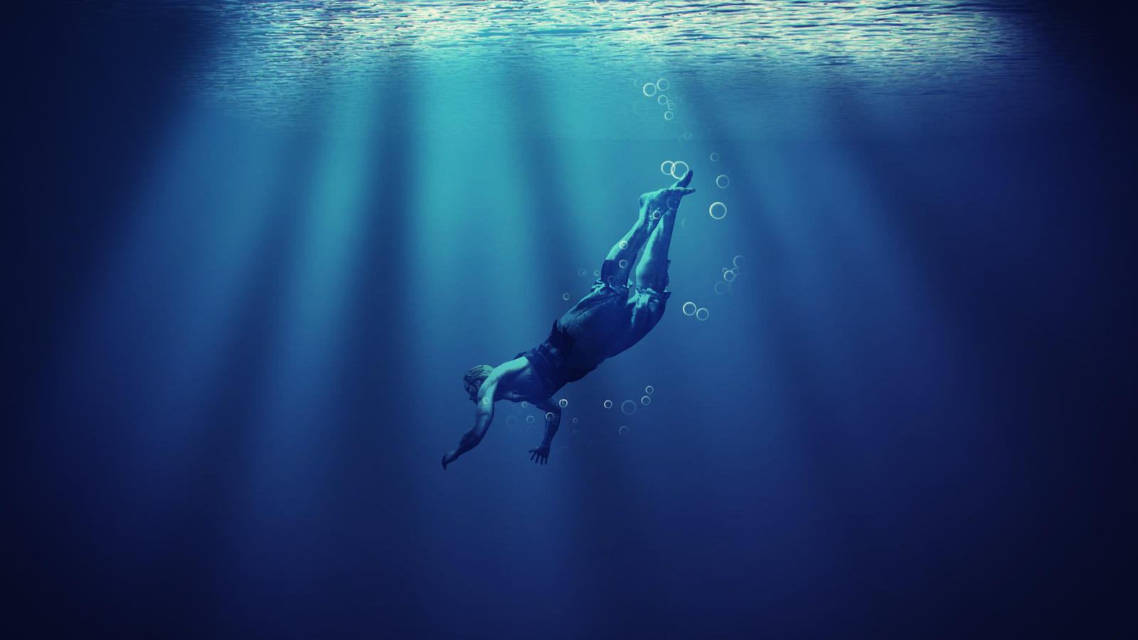
Let’s dive deep in
Understanding algorithms
This Photo by Unknown Author is licensed under CC BY-NC-ND

Slide 11

Face Detection (Open Cv)
Feature extraction
Running OpenCv
Haar Cascade training data addition
OpenCV module
detectMultiscale
scaleFactor
minNeighbors
minSize

Slide 12

Face Recognition
Viola-Jones Face Detection (Haar cascade)
- A sequence of rescaled “square-shaped” functions which together form a wavelet family or basis.

Slide 13
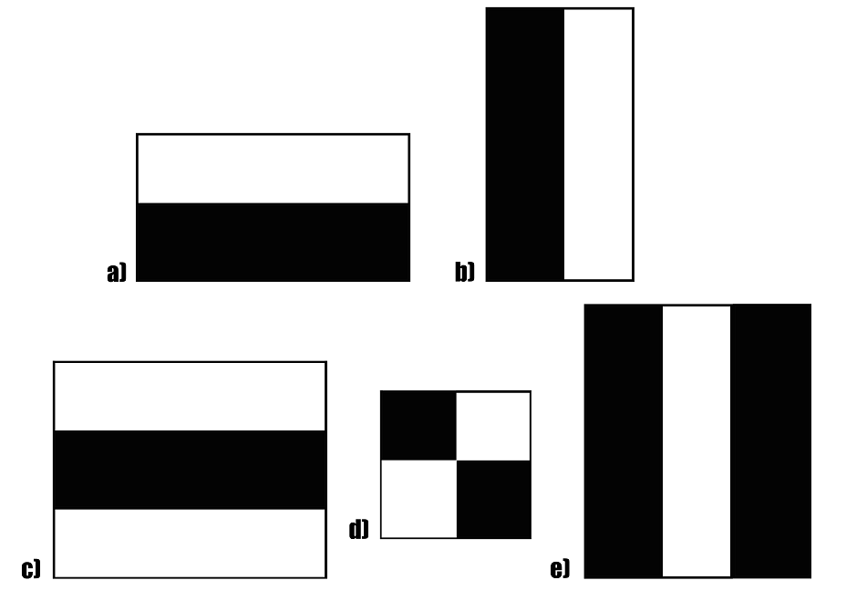
Fig. A sample of Haar features.

Slide 14
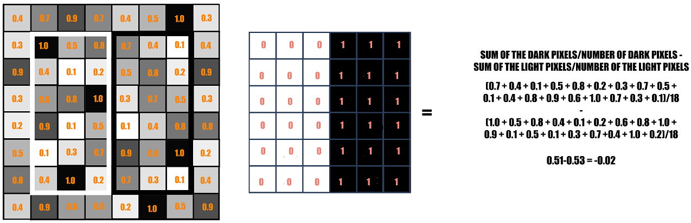
Fig. If the difference is close to 1, then there is an edge detected by the haar feature.

Slide 15
Fig. The GIF shows how a haar feature traverses on an image from its left towards its right.

Slide 16
Fig. The GIF shows the making of an Integral Image. Each pixel in an Integral image is the sum of all the pixels in its left and above.

Slide 17
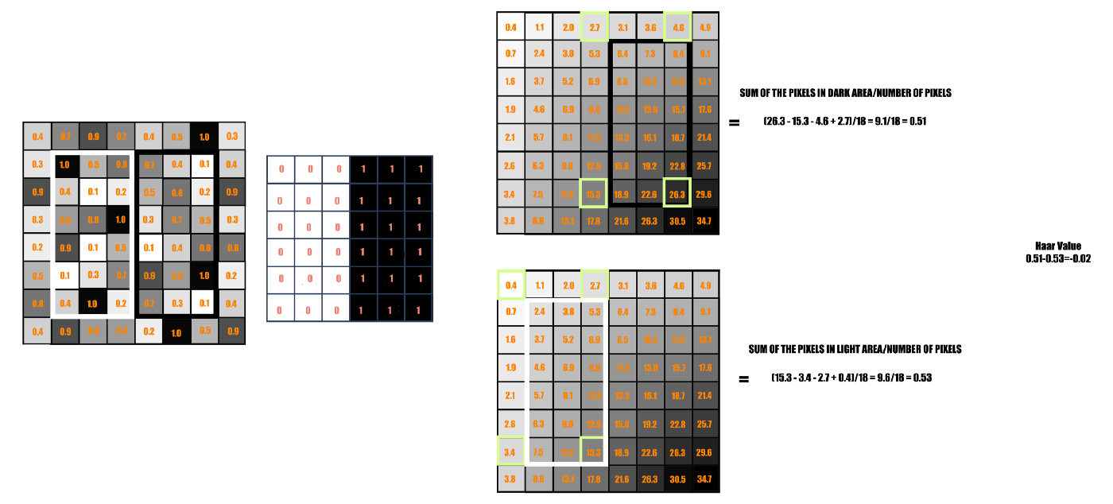
Fig. Integral Image is used here to calculate the haar value.

Slide 18
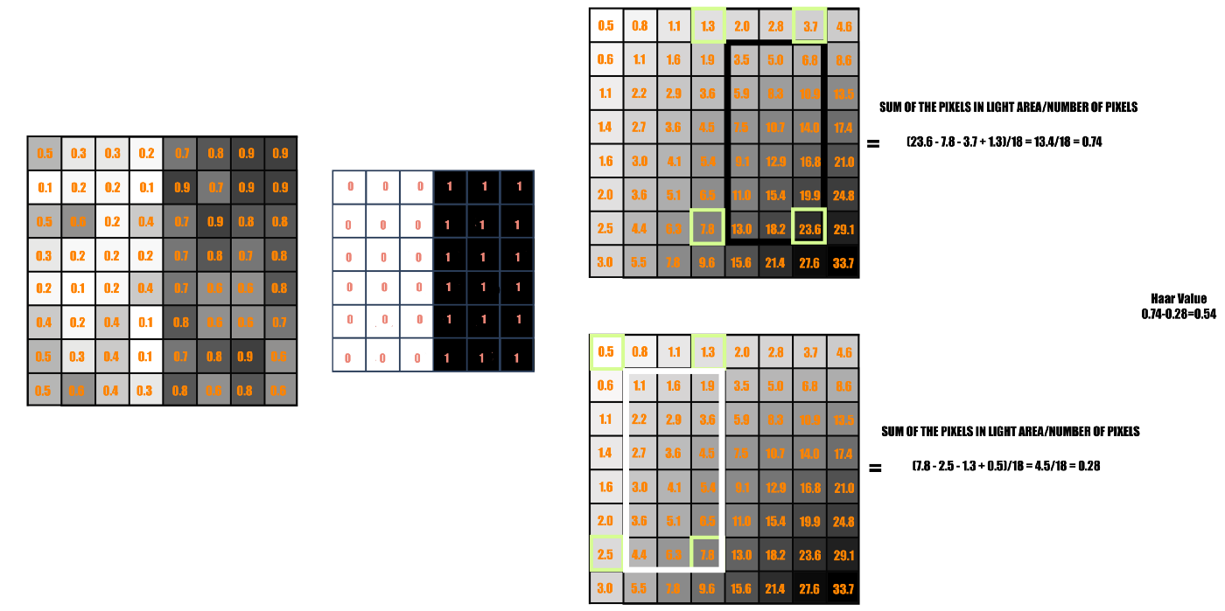
Fig. Haar calculation from Integral Image. This is a case where there is a sudden change of pixel intensities moving vertically from the left towards the right in the image.

Slide 19
Fig. Attentional Cascade

Slide 20
Fig. Feature Detection on an Image containing a face

Slide 21
Features of our project
Saving profile for future use
Saving images for training for future
Marking Attendance with date and time in excel sheet.
Separate id & password for every student.
Automatic Email

Slide 22
Steps for achieving this project
Saving id & password for each student individually
Capturing all the students' images and training them through classifier.
Apply OpenCv modules for face recognition.
Detect all students’ faces through haar cascade algorithm.
Automatic attendance analysis module in Excel Sheet.
Notifying students of successful attendance via email.

Slide 23
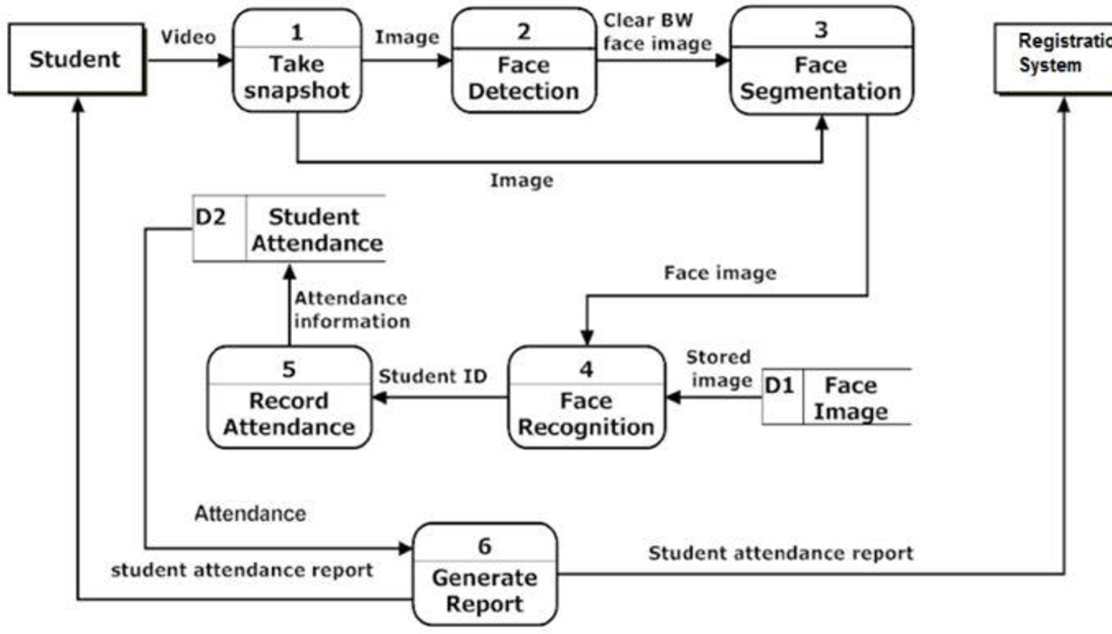

Architectural
Diagram
via Email

Slide 24
RESULTS

Slide 25
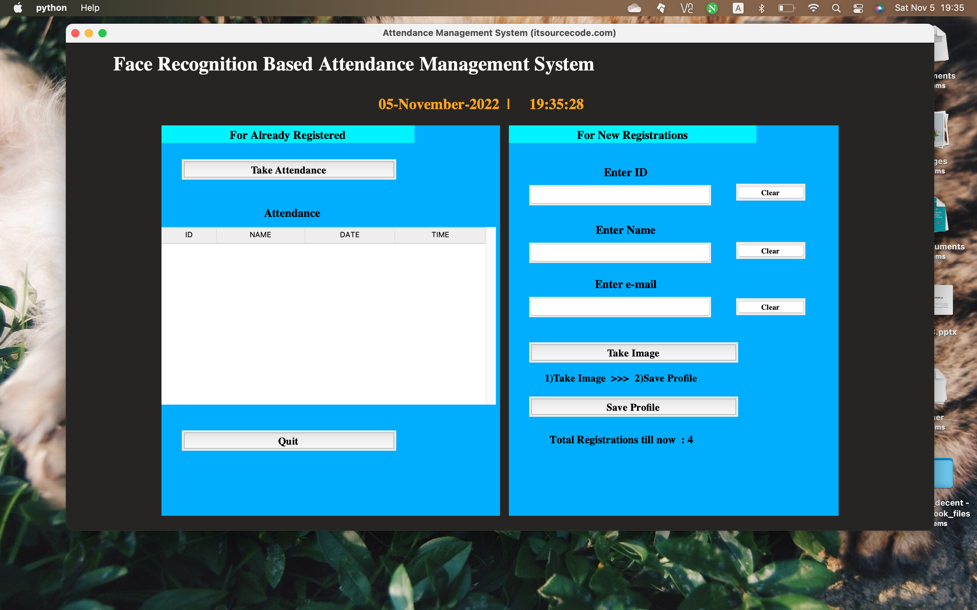
FRONT-END

Slide 26
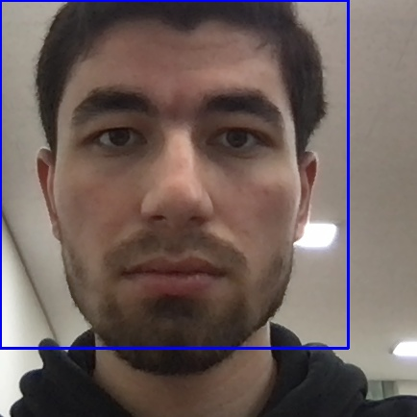
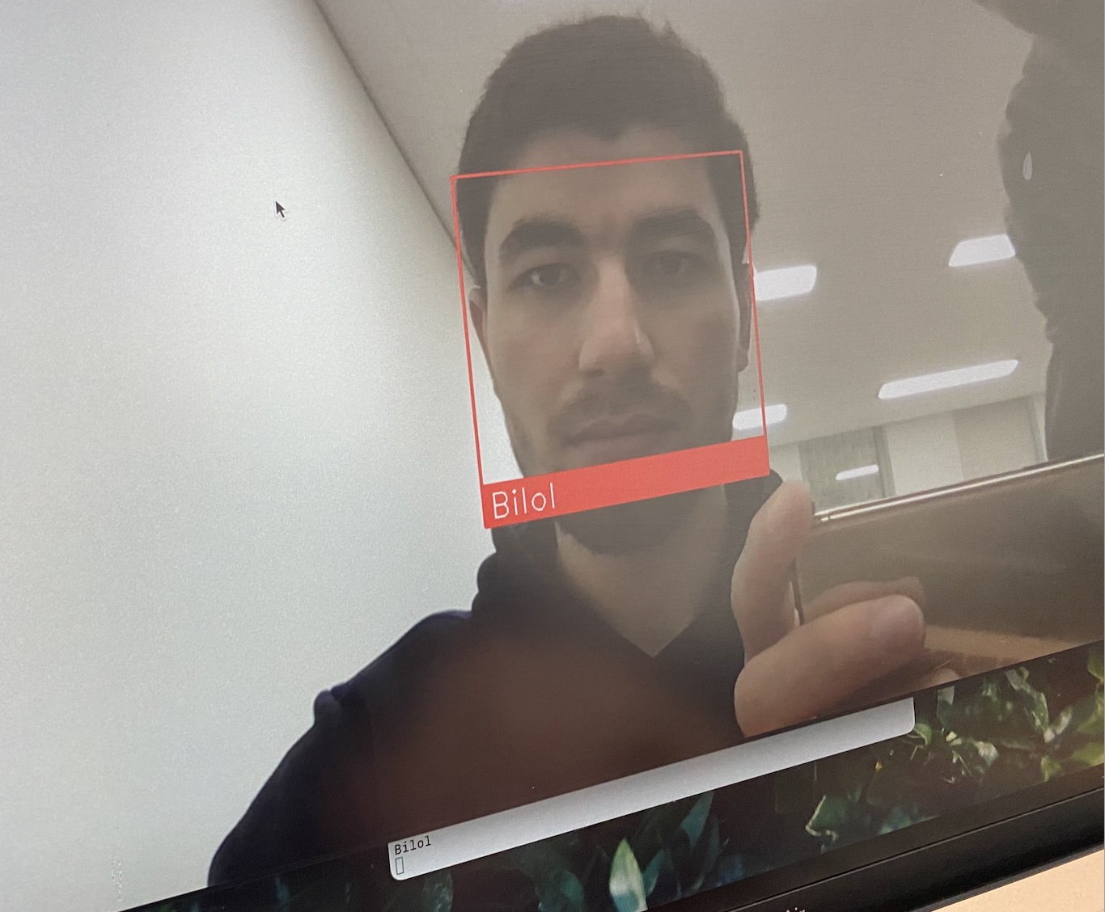
Detection
Recognition

Slide 27

Back-End

Slide 28

Things that one should Try to avoid.
In order to detect face correctly.

Slide 29

Pretending to be Someone else

Slide 30

Makeup

Slide 31

Eyes

Slide 32
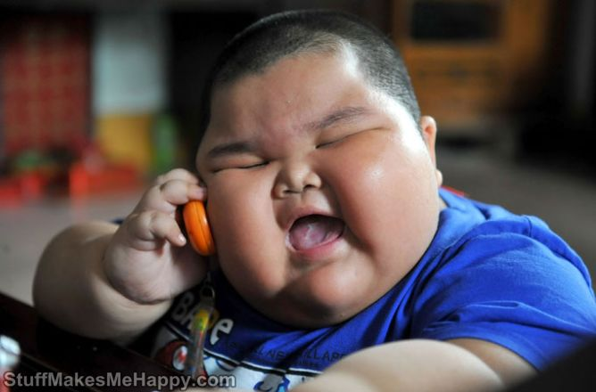
Face

Slide 33
MILESTONES
11th week
Goal
Full-fledged software by providing automated and a reliable attendance system which uses face recognition technology.
Testing and Training period
Capturing and training student's images.
Working on the recognition speed
10th
Week
9th
week
Linking pages
7- 8th
week
Putting our code parts together, making every function work chronologically.
Finish updating
Database and email configuration
Excel sheet configuration
Email client addition
1-6th week
Collecting data
Reflecting on feedbacks
Choosing an optimistic project
Module collection
Environment configuration.
Implementation of algorithms.

Slide 34
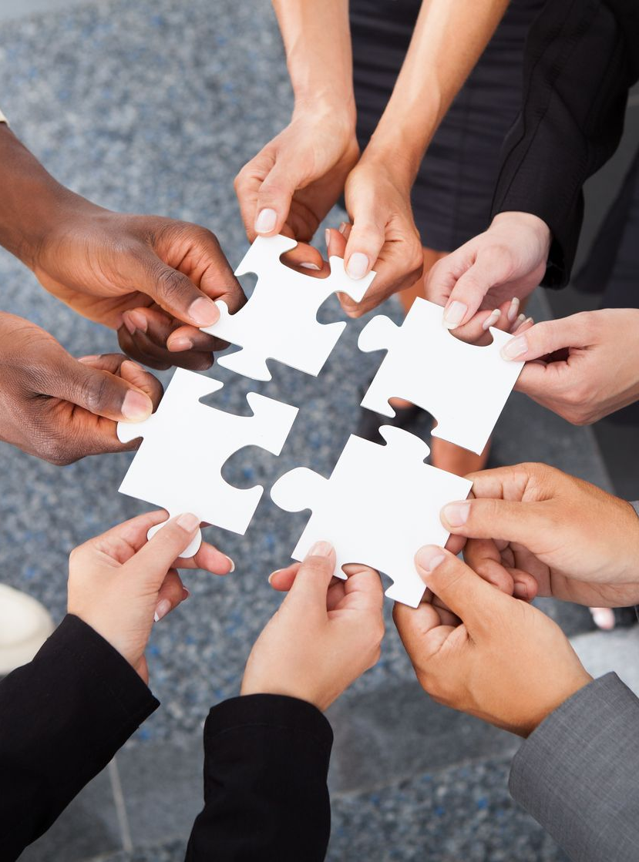
Competitive
Analysis
3. Radio frequency Identification
N.A.A.S (Viola-Jones algorithm)
(accuracy in terms of algorithms)
4. Iris-attendence
5. Viola-Jones and Histogram of Oriented Gradients face recognition
A : No.6 seems to get more accuracy but not every single time
B : No. 7 scores 82% but, is stable than the one algorithm proposed in 6.
C: We placed Our project- NAAS between iris and RFID attendance system. Since it less accurate than iris but more accurate and secure than RFIDS
7. Face recognition by DWT and DCT and applying RBF for classifying
82%
6. Eigenface and Fisher face Recognition algorithm
70-90%

Slide 35
Things to Improve :
Better interface
Innovative, useful product, aesthetic, detailed.
Improved Security
NAAS
Images stored on servers, must
be impossible for a person to use that image.
Messaging and alerting
District Communications, such as messaging and alerting

Slide 36


Everybody will not get consistent results, they will all depend on the parameter values set for scaleFactor, minNeighbors and minSize.
There is no exact value to detecting the number of faces. The user will have to use arbitrary values to produce face detection. The code can detect faces, but it would still require verification from the user. This is therefore not a fully intelligent system since it requires interaction from the user.

Slide 37

Thank you

Slide 38

LET'S SEE A LIVE DEMO !!!!

